Slide 1



The CHAMP Plan ™
Introducing
Engage | Educate | Monitor | Manage

Slide 2
















Companies The CHAMP Plan™ Works With

Slide 3

First Things First on The CHAMP Plan™
How it Started
Providing essential healthcare to as many employees as possible at little to no cost.
Utilize technology to engage individuals to educate and help them improve their overall health
How it Works
Complement not Compete with primary medical
Frontline of Defense
Proactive not Reactive Healthcare
Real Benefits employees can use regularly
How it’s Funded
Enrolled Employees generally see an Increase in their net pay
Employers realize a Net Savings when offering the plan

Slide 4


The CHAMP Plan™ Benefits (Pre-Tax)
Unlimited Primary Care Doctor / Urgent Care Visits
The Plan pays 100% of the office visit charges for First Health Providers for the employee. (Employee Only)
100% Preventative Care
The Plan pays 100% of services required by the Patient Protection and Affordable Care Act through First Health Providers. (Employee Only)
Unlimited Prescriptions $0 Copay
No copay or cost for 85% of the most commonly prescribed medications within the Champ formulary (Employee plus family)
Direct Primary Care (Employee plus family)
$0 Cost Unlimited access to a Concierge’s advocate approach to health care.
It’s having a doctor available 24/7 at your beck and call.
Personal & Mental Health Care (Employee Plus Family)
Proactive Medical Care to help identify potential health risks
Access to private consultations
Benefits are available to Employees, Employees + Spouse/Partner and Children. See details on Fulfillment documentation.

Slide 5


The CHAMP Plan™ Benefits
Direct Primary Care
Our Board-Certified Doctors can diagnose your symptoms,
prescribe medication and send prescriptions to your pharmacy of choice.
We treat most non-emergency conditions such as:
Mental & Behavioral Health
Licensed Therapists and Counselors available anytime, anywhere.
Talk to us for issues such as:
Abdominal Pain/Cramps
Abscess
Acid Reflux
Allergies
Animal/Insect Bite
Arthritis
Asthma
Backache
Blood Pressure Issues
Bronchitis
Bowel/Digestive Issues
Cellulitis
Cold
Constipation
Cough/Croup
Diarrhea
Dizziness
Eye Infection/Irritation
Fever
Flu
Gas
Gout
Headache/Migraine
Herpes
Joint Pain/Swelling
Laryngitis
Pink Eye
Poison Ivy/Oak
Rash/Skin Injury
Respiratory Infection
Sinusitis
Sore Throat
Sprains & Strains
STD’s
Strep
Tonsilitis
Vaginal/Menstrual Issues
Yeast Infection
And More
ADHD
Addictions
Anger Management
Anxiety
Bipolar Disorders
Bullying
Career/Job Related Stresses
Child and Adolescent Issues
Depression
Divorce
Eating Disorders
General Life Coaching
Grief and Loss
Life Changes
Nutrition Counseling
Panic Disorders
Parenting Issues
Postpartum Depression
Relationship and Marriage Issues
Self-Image
Stress
Substance Abuse
Trauma and PTSD
And more

Slide 6
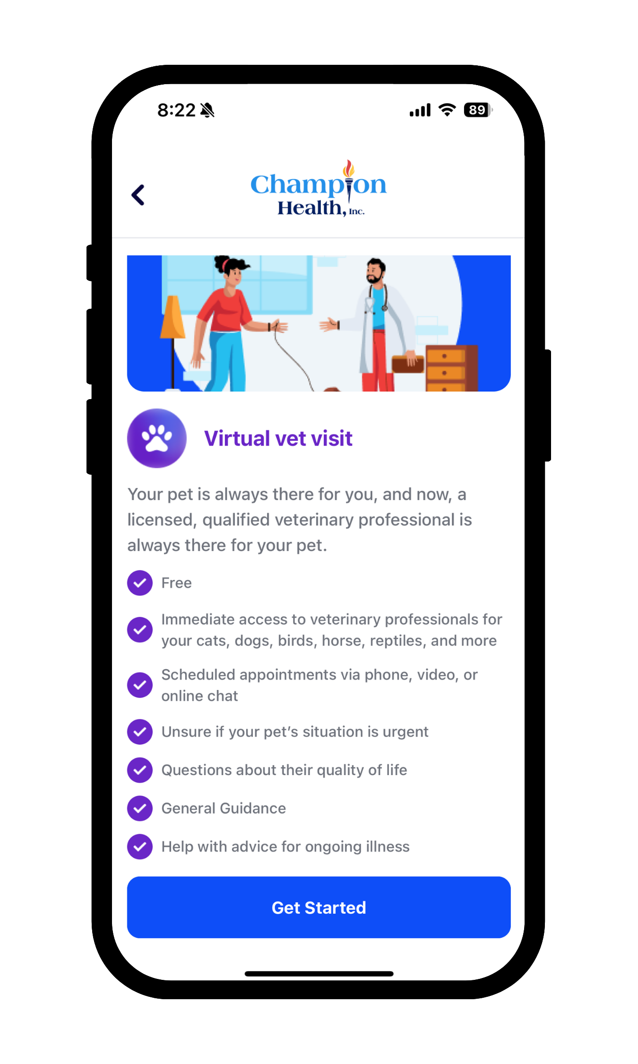
Additional Benefits of The CHAMP Plan™
At Home Lab Testing
Easy to use kits sent directly to your doorstep. The kits include a variety of test, such as: Complete Metabolic Panel, Complete Blood Count, Enhanced Lipid Panel and more. All designed to be proactive in individual’s health. (Employee Only)
Vitals Tracking
Monitor your vitals, set goals and build healthy habits with personalized insights all from the comfort of your home. (Employee plus Family)
Unlimited Virtual Veterinary Consultations 24/7
Our Licensed Veterinary professionals inform, advise and guide you on the steps to take for the health and well-being for cats, dogs, horses, birds, and more. (Employee plus Family)

Slide 7
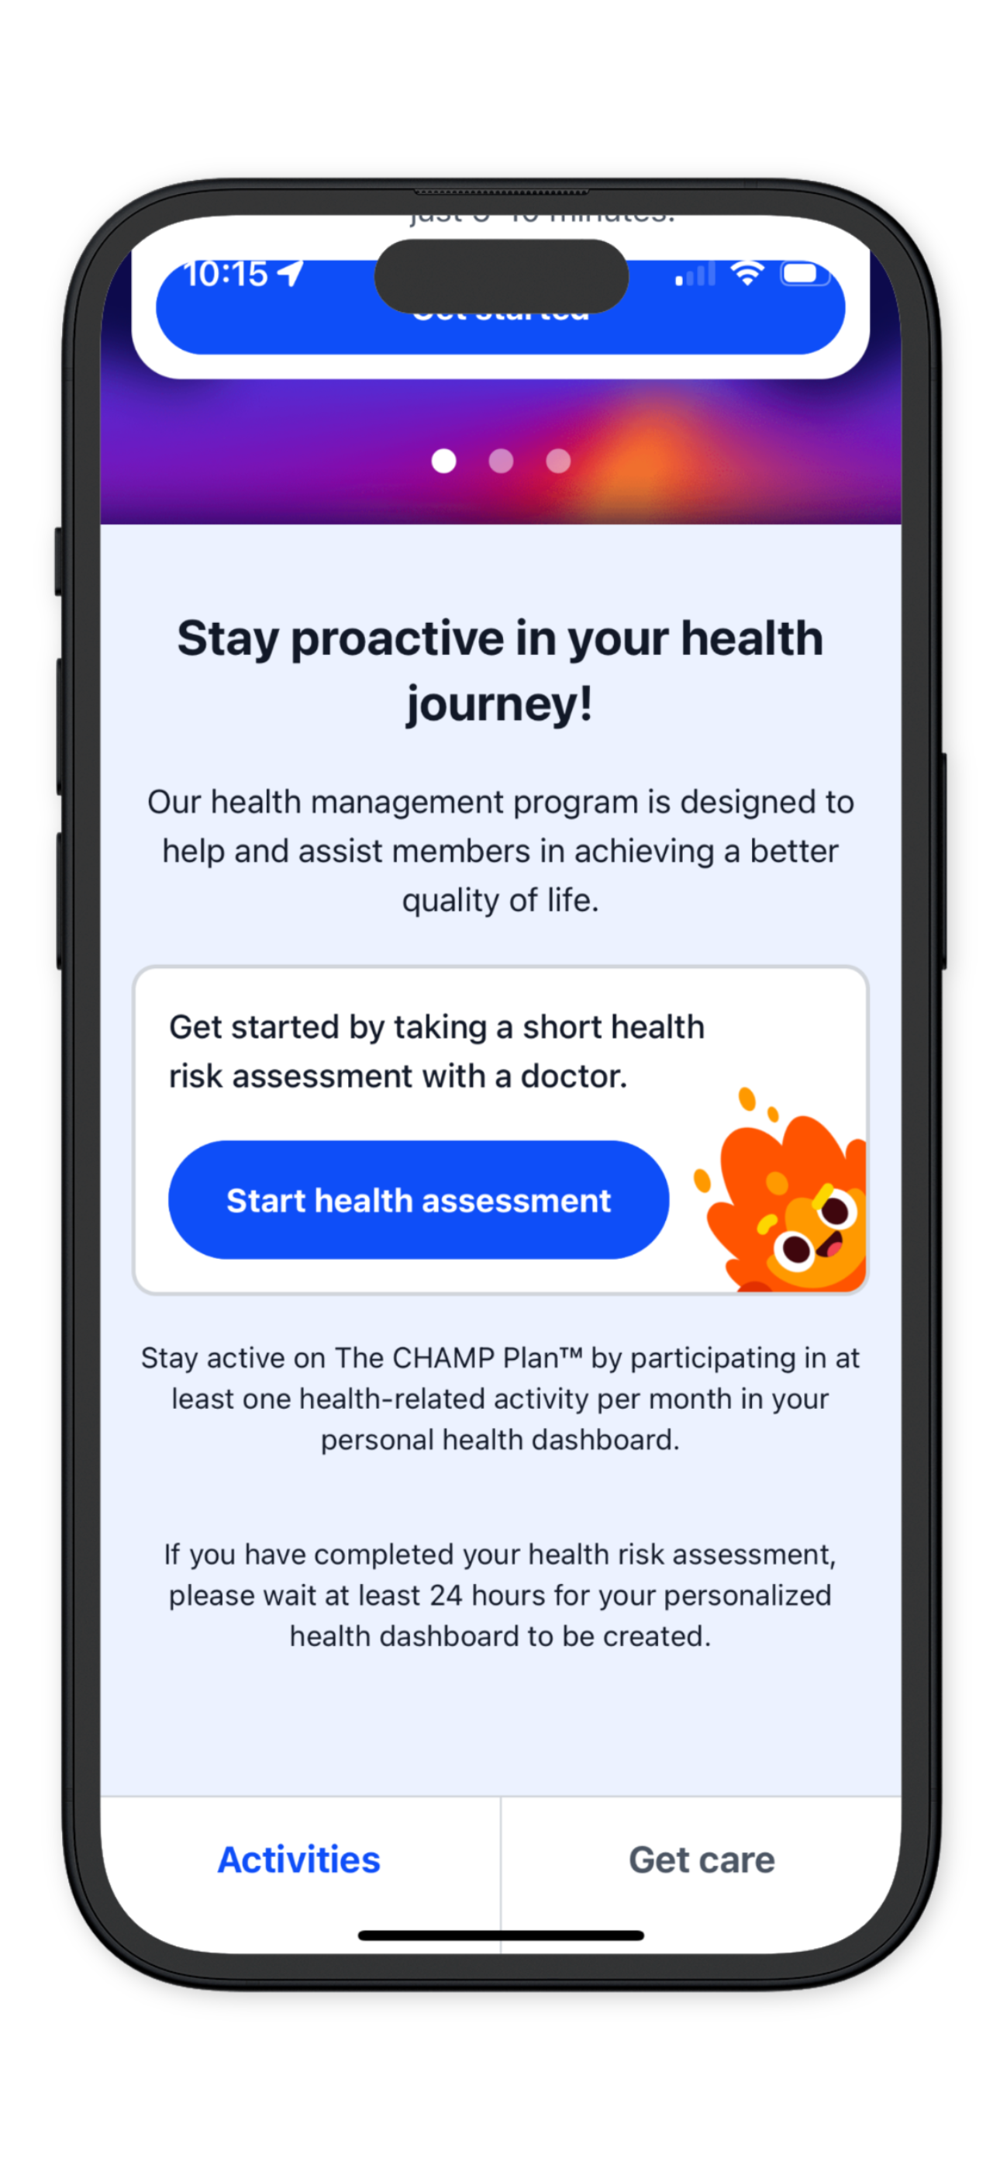
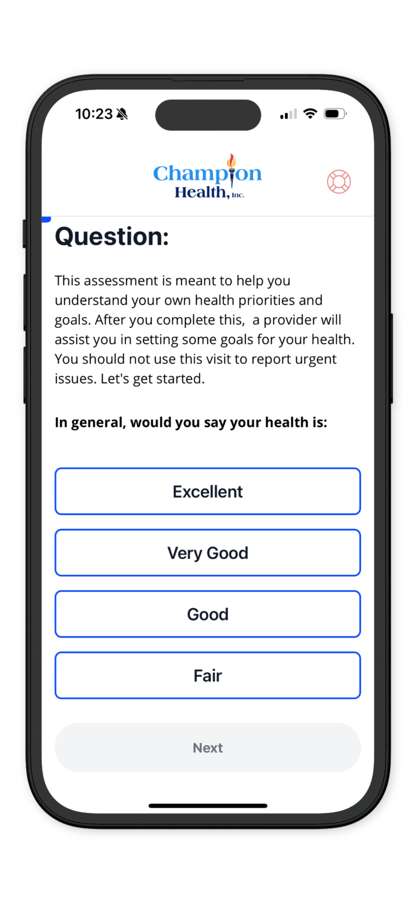
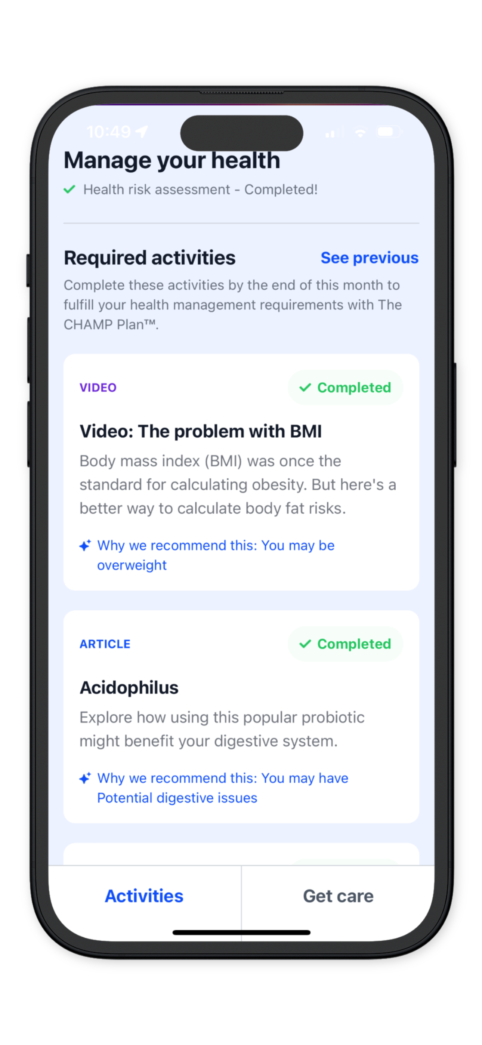
The CHAMP Plan™ Introducing CHAMP Proactive
*Each interaction with the Champ Plan generates CPT Codes to help substantiate the Champ Plan benefits.

Slide 8
Before and After Employee Paycheck Example
Current Paycheck (Monthly)
Paycheck with the Champ Plan
Employee
Harry Potter ^
Employee
Harry Potter ^
Total Taxes Saved
Earnings
Earnings
Gross Pay
$4,000.00
Gross Pay
Champion Benefit
$4,000.00
$1,130.00
$ 306
Tax Withholdings
Federal Withholding
Social Security
Medicare
State Withholding
Deductions
Pre- Tax Deductions
Post- Tax Deductions
Champ Plan (Pre-tax)
Champ Plan Premium (Post-tax)
($138.50)
($165.85)
($38.79)
($61.21)
($175.00)
($50.00)
($1,200.00)
($120.00)
Champ Employee Net Cost
Tax Withholdings
Federal Withholding
Social Security
Medicare
State Withholding
Deductions
Pre- Tax Deductions
(401k - $50, Health Insurance - $125)
Post- Tax Deductions
(Roth)
($289.12)
($240.25)
($56.19)
($125.10)
($175.00)
($50.00)
$ (190)
Employee Paycheck Increase Per Pay Period
$ 116
Net Pay
$3,064.34
Net Pay
$3,180.86

Slide 9
Employer Savings for 100 Employees
Potential Annual Savings for Company
$57,360.00
Individual Employee Monthly Breakdown
Champ EE Pre-Tax Deduction | $1,200.00
x 7.65 % FICA Payroll Savings | $ 91.80
Less Admin Fee | $ (44.00)
Monthly Per Employee Saving | $ 47.80

Slide 10
General Overlook of The CHAMP Plan™ Transactions
The great thing about The CHAMP Plan™ is there is a net savings for the employer, but we want to clarify the costs.
There will be a $234 per employee per month Invoice sent to the company.
$44 PEPM is the administration fee for the company.
$190 PEPM is coming from the withholding of the individual employee that the company will send to Champion Health on the employees’ behalf. *Reminder these are dollars you would have paid the employee normally without having the Champ Plan.
Employee Sec 125 Deduction | $1,200.00
x 7.65 % FICA Payroll Savings | $ 91.80
Less Admin Fee (Paid to Champion) | $ (44.00)
Monthly Per Employee Saving | $ 47.80
Employee Sec 125 Deduction | $1,200.00
Less Net Champion Benefit | $(1,010.00)
Monthly Paid to Champion | $ 190

Slide 11
The CHAMP Plan™ First Step
Generate a Custom Proposal
We need a payroll census for the most recent pay period.
Ideally most recent paystubs in PDF format.
PDF report is often called “Payroll Register” or “Payroll Journal”
Please only recent pay period and not YTD
The report needs employee by employee Gross to Net Pay with itemized deductions and taxes.
If its easier we can also provide a payroll census template, you can manually complete.
Upload Census to Secure File Upload Link

Slide 12
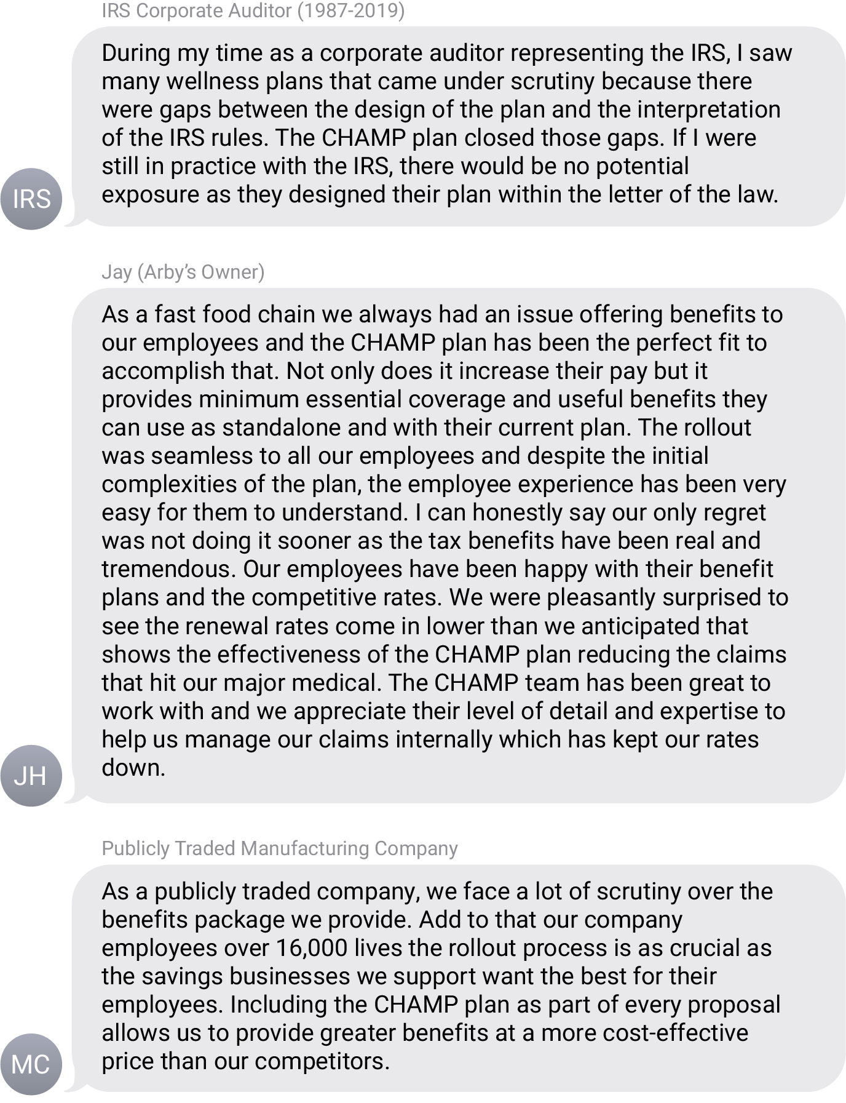
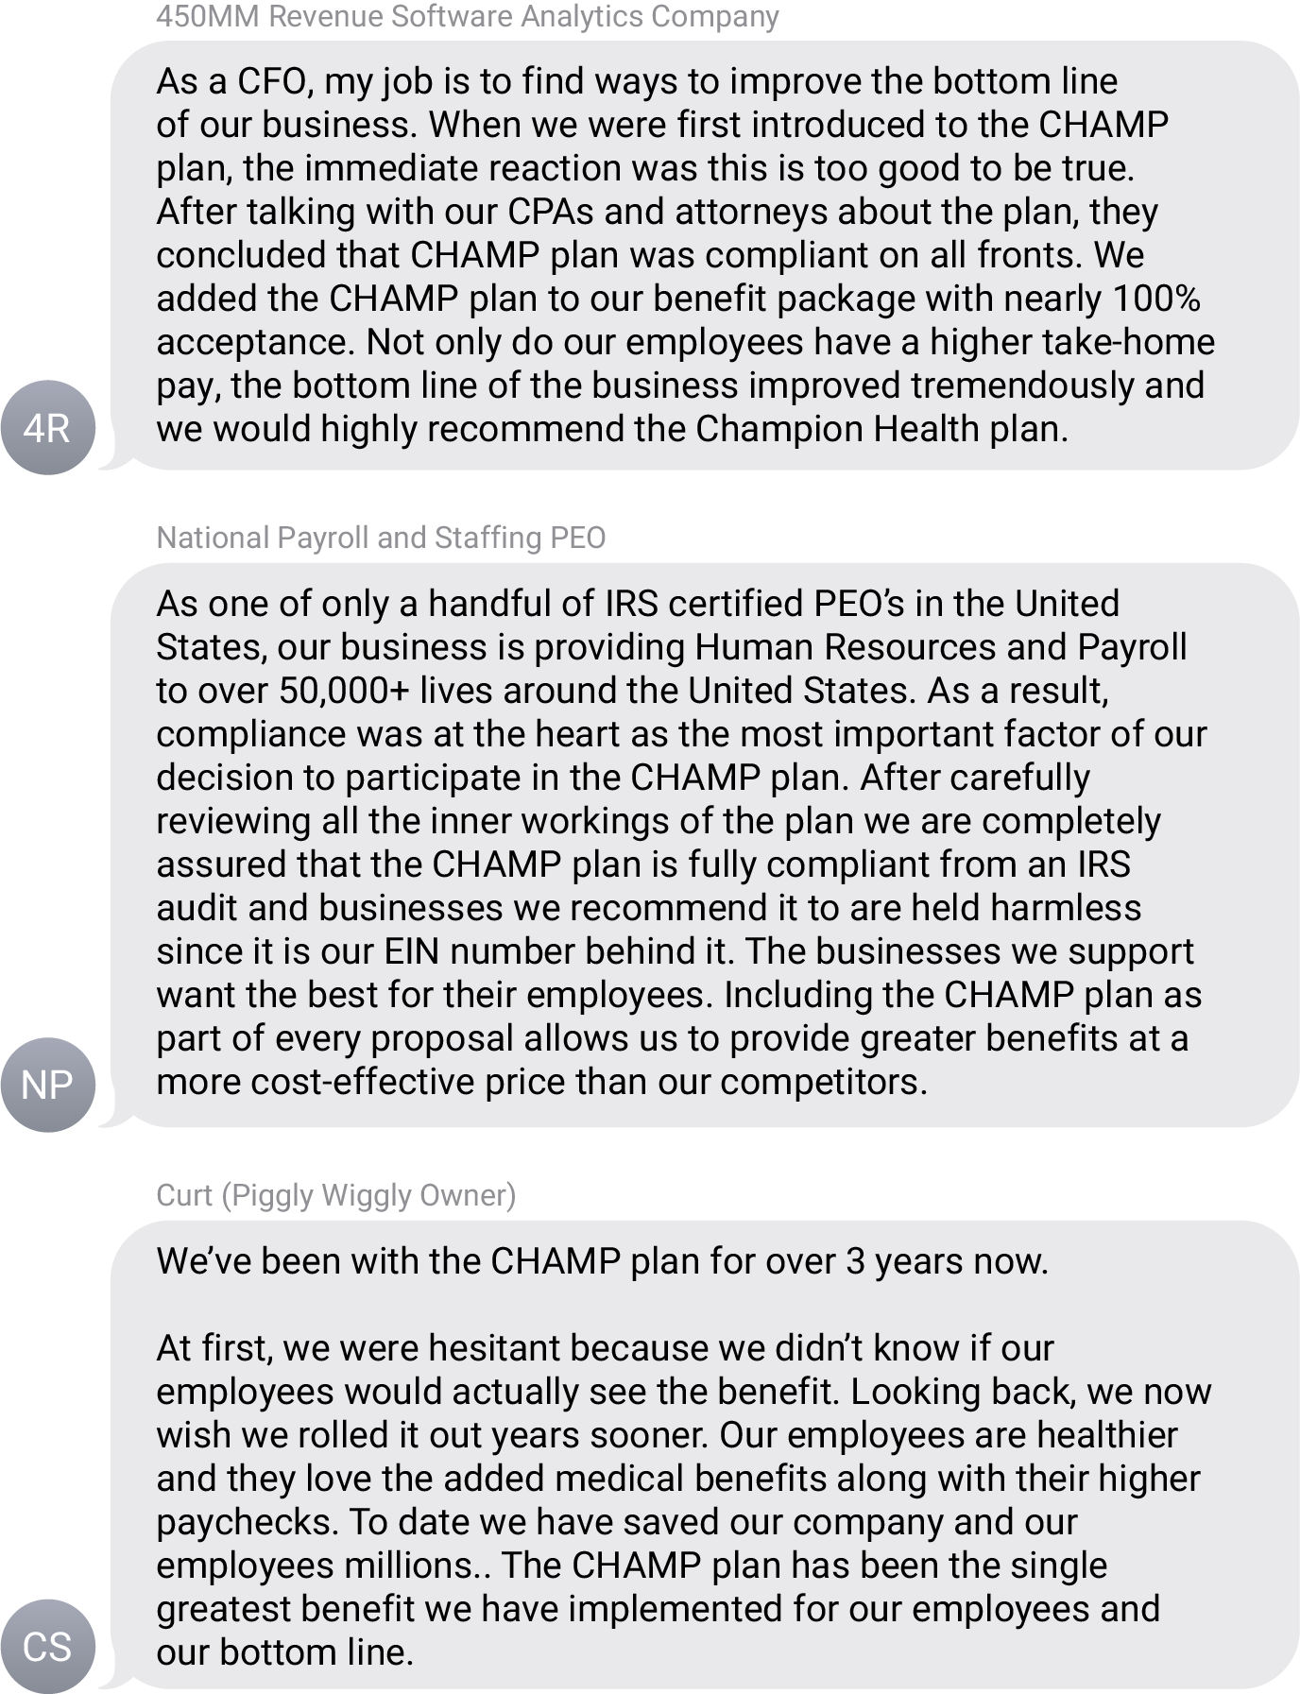
The CHAMP Plan™ Testimonials

Slide 13
The CHAMP Plan™ Disclosures
Please see, Summary Plan Description and controlling Plan Document, as required by the Employee Retirement Income Security Act of 1974, 29 U.S.C. et seq. (ERISA), for the full details of the CHAMP™ Employee Benefit Plan
Discrimination: The Plan is intended to not discriminate in favor of highly compensated individuals as to eligibility to participate, contributions and benefits in accordance with applicable provisions of the IRS Code. The Plan Administrator may take such actions as excluding certain highly compensated individuals from participation in the Plan or limiting the contributions made with respect to certain highly compensated Participants if, in the Plan Administrator's review and judgment, such actions serve to assure that the Plan does not violate the applicable nondiscrimination rules.
Privacy and Security: We are required by law to maintain the privacy and security of any personally identifiable health information. Although the CHAMP™ Plan and the Plan Sponsor may use aggregate information it collects to design a program based on identified health risks in the workplace, the Plan Sponsor will never disclose any personal information either publicly, except as necessary to respond to a request for a reasonable accommodation needed to participate in the CHAMP™ Plan, or as expressly permitted by law. Personally identifiable medical information provided in connection with the CHAMP™ Plan will not be shared with the employer and may never be used to make decisions regarding employment. Additional copies of our Notice of Privacy Practices are available by calling the Plan Sponsor at the phone number included in Article II - Introduction and Purpose; General Plan Information.
Mental Health Parity: Pursuant to the Mental Health Parity Act (MHPA) of 1996 and the Mental Health Parity and Addiction Equity Act of 2008 (MHPAEA), collectively, the mental health parity provisions in Part 7 of ERISA, If this Plan covers mental and substance benefits, it applies terms uniformly and enforces parity between covered health care benefits and covered mental health and substance disorder benefits relating to financial cost-sharing restrictions and treatment duration limitations. For further details, please contact the Plan Administrator.
Applicable Law: This is a self-funded benefit plan coming within the purview of the Employee Retirement Income Security Act of 1974 (“ERISA”). The Plan is funded with Employee and/or Employer contributions. As such, when applicable, Federal law and jurisdiction preempt State law and jurisdiction.
HIPAA: The Plan Sponsor agrees that the Plan will follow all requirements involving the use or disclosure of protected health information as provided for in 45 C.F.R. Part 164. The Benefits Coordinator’s duties and responsibilities in connection with the requirements imposed by HIPAA and regulations promulgated thereunder will be set forth in a separate agreement between the Parties. In the event the Plan submits claims or eligibility inquiries, or any other HIPAA Covered Transaction as defined in 45 C.F.R. Part 160 and 162 to the Benefits Coordinator through electronic means, the Plan and the Benefits Coordinator shall comply with all applicable requirements of HIPAA and the Plan and the Benefits Coordinator shall require any of their respective agents, business associates or subcontractors to comply with all applicable requirements of HIPAA.
HIPAA Privacy: The Plan provides each member with a separate Notice of Privacy Practices. This Notice describes how the Plan uses and discloses Personal Health Information. It also describes certain rights of enrollees regarding this information.
Tax Disclaimer: The information provided in this document is intended for general informational purposes only and does not constitute legal, tax, or financial advice. The accuracy, completeness, adequacy, or currency of the information is not warranted or guaranteed. It is your responsibility to verify any information before relying on it. This document may not cover all applicable tax laws or rules, which are subject to change at any time without notice. You should seek the advice of a qualified tax professional or other advisor to determine the most appropriate tax treatment for your individual circumstances. We assume no liability for any reliance on the information provided in this document or for any errors or omissions in its content.
Brand Identification: Any reference to a recognized brand does not constitute or imply any relationship or affiliation with, CHAMP™, or any of its business associates. Client relationships may be limited to one or more franchise owners of the national brands and is not intended to imply they entire brand is utilizing CHAMP™
Testimonial Disclaimer: Any testimonial provided by, a satisfied customer of CHAMP™, or any of its affiliated business associates. They were not compensated or provided with any incentive for providing these testimonials. Champ is not responsible for any opinions or statements made by any party in these testimonials.
Please see the full plan document for a list of exclusions and limitations.

